Slide 1

Where to Open a New Pharmacy in Houston
Contoso Pharmaceuticals
Arman Khodabakhshnejad

Slide 2
Problem Statement
Houston is a large city with a dramatic growth in the past decade.
Pharmacies and medical facilities are not distributed uniformly throughout the neighborhoods.
Finding a right neighborhood for a new pharmacy is a challenge for pharmacists.

Slide 3
Data Acquisition
Map of the city of Houston
Boundary of neighborhoods
Location of pharmacy and drugstores in the city of Houston
City of Houston (Shape file)
City of Houston (KML file)
Foursquare API

Slide 4
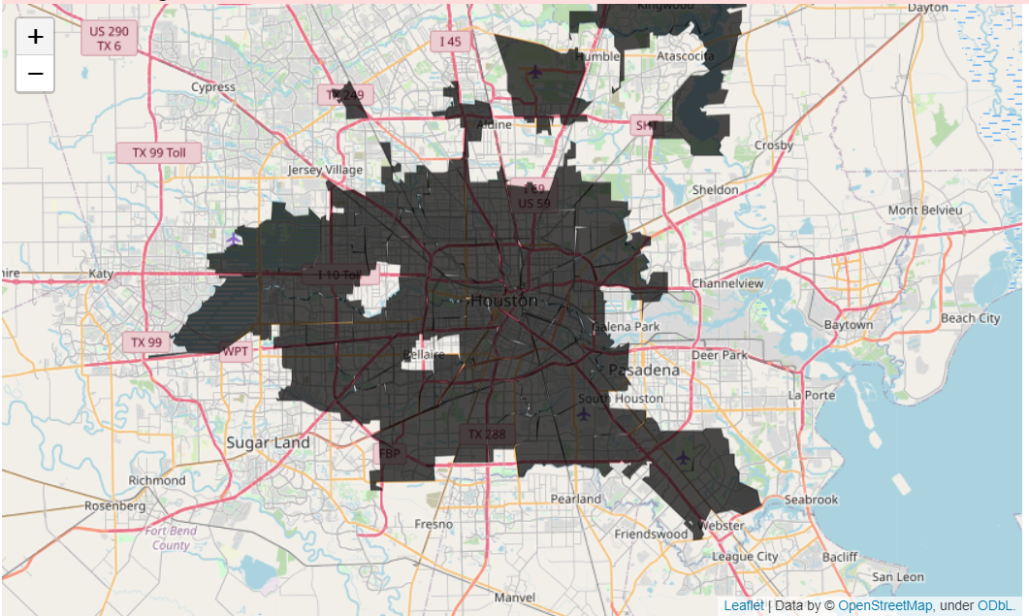
Map of City of Houston

Slide 5
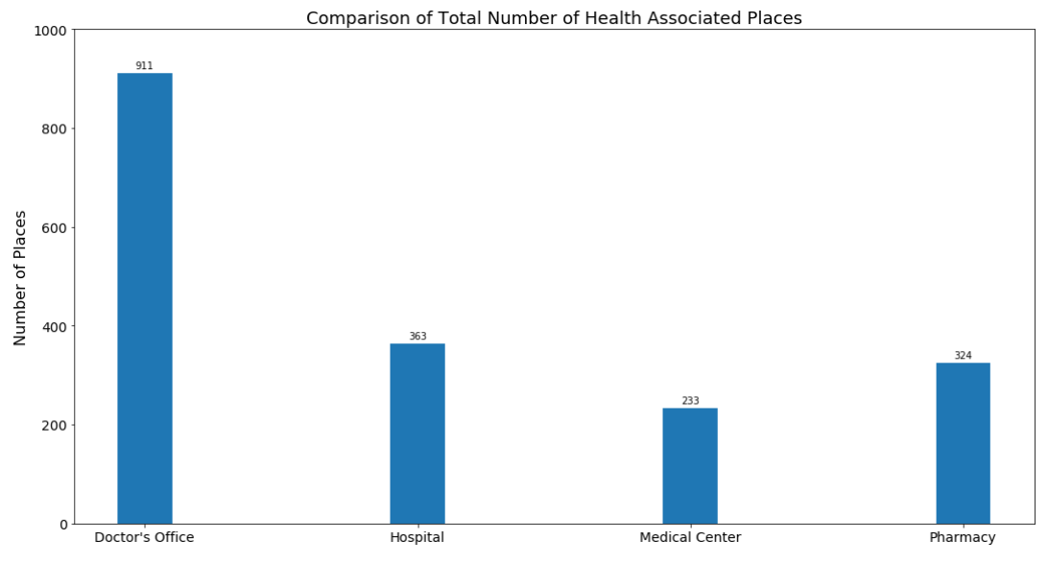
Medical Facilities and Pharmacies

Slide 6
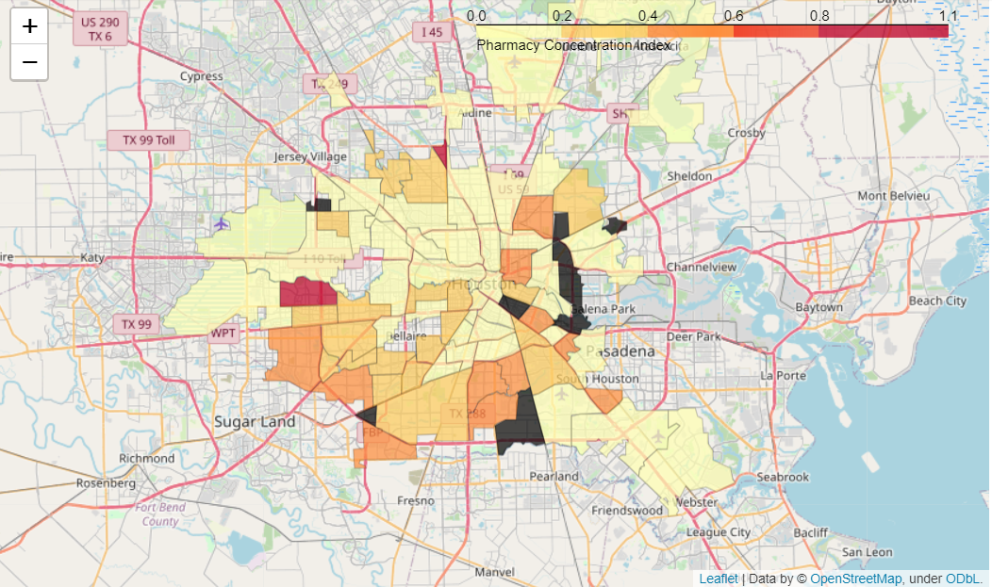
Pharmacy Concentration Index
Many neighborhoods have a shortage of pharmacy.
South part of Houston is better equipped with medical supplies than the rest of the city.
Several neighborhoods are not populated, therefore, they do not need any medical facility.

Slide 7
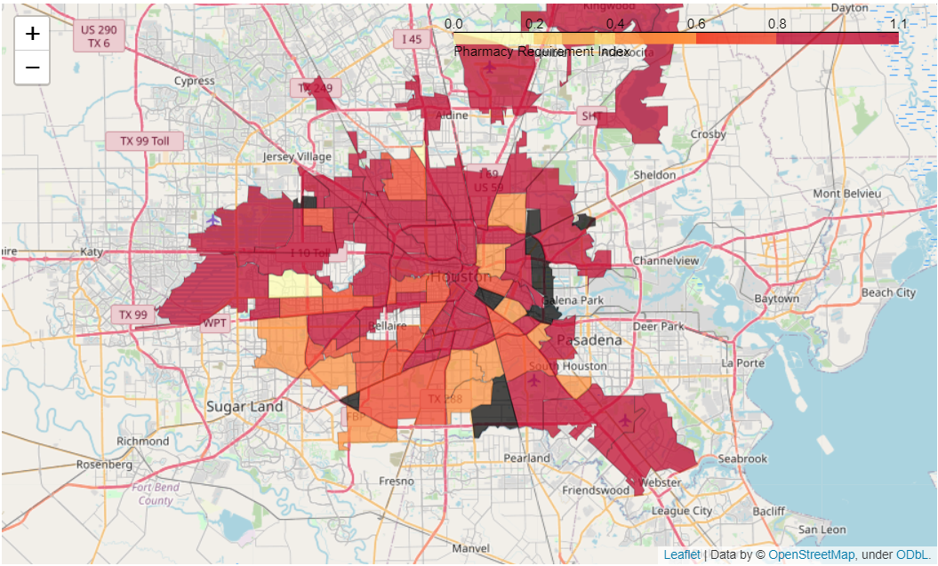
Pharmacy Requirement Index
It highlights the neighborhoods that are better suited for the pharmacy.
The shortage of pharmacy is more severe in the west and north.

Slide 8
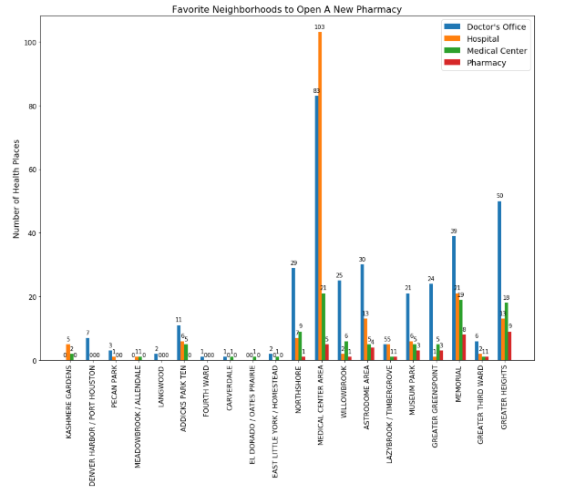
Neighborhoods With Higher Pharmacy Requirement Index
The first ten neighborhoods do not have any pharmacy.
Some of the neighborhoods without any pharmacy are not suitable to open the pharmacy as a result of low density of medical facilities.
Medical center has high Pharmacy Requirement Index as a result of high concentration of medical facilities..
No pharmacy

Slide 9
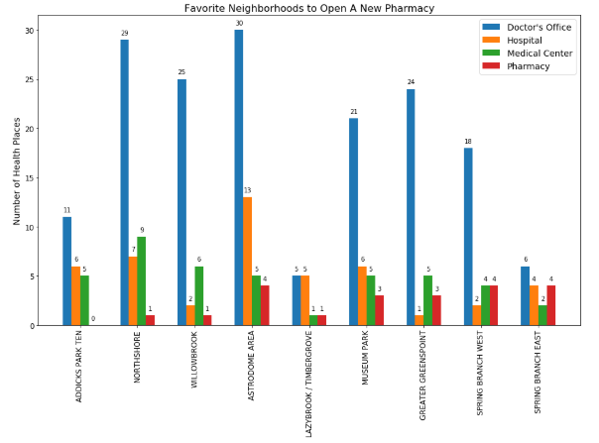
Neighborhoods to Open the Pharmacy
There are at least 10 medical facilities in each of these neighborhoods.
The competition is not severe in these neighborhoods. There are not more than four pharmacies in the area.
Addicks Park is the best candidate in term of balance between number of pharmacies and medical facilities.

Slide 10

Evaluating Neighborhoods Based on Priorities
Low Competition-High Concentration of Health Care Facilities
Good for small to mid-size pharmacy
Close to Downtown
Close to Medical Facilities
Good for a large pharmacy

Slide 11
Conclusion
Extensive private and public resources are leveraged to provide recommendations for a pharmacist aiming to open a pharmacy in the city of Houston.
Various scenarios are evaluated based on the budget and the size of the new pharmacy to recommend the neighborhood.
Visualization of the data in the Folium open library allowed us to identify the neighborhoods with high pharmacy density on the map.
Analysis showed that Addicks Park Ten, Medical Center Area, and Lazybrook are the best candidates for an opening a new pharmacy if the priorities are limited competition, access to a large market, and closeness to downtown, respectively.

